Slide 1
23/24

Slide 2
Design Technology Curriculum Principles.
By the end of their secondary education, a student of Design Technology at Dixons Brooklands Academy will:
Have the knowledge, understanding and skill sets required to succeed in one of the many career paths linked to Design Technology.
Be resourceful and innovative learners, who can apply their subject knowledge and practical skills to overcome obstacles and barriers enabling them to compete in a rapidly developing industry.
Have a sense of achievement and success making them resilient learners who are equipped to solve real world problems through high quality solutions, systems and products.
Know and understand the vital skills and knowledge required to ensure a self-sufficient, independent lifestyle contributing and maintaining a well-balanced and healthy living.
In order to achieve a true understanding of Design Technology, topics have been intelligently sequence based on the following rationale:
At the core of all lessons is knowledge and understanding. Coinciding with this is practical knowledge and application which provides a tangible learning experience which deepens students’ understanding and further builds schema.
The sequence of content delivered in Design and Technology aids progression and allows for the accumulation of sufficient knowledge and skills needed for future learning, linking to Local, National and Global Industries.
Key Stage 4 builds on the learning from Key Stage 3, delivering the knowledge and understanding and skills sets required for coursework and practical examinations.
Schemes of Learning content reflects the subject specifications within the following arenas - Photography, Graphic Design, Construction and Design Technology.
Students explore a diverse array of themes, Artists/designers and makers through a holistic approach.
Students embed and articulate practical skills to a high-quality finish.
The Design Technology curriculum will address social disadvantage by addressing gaps in students’ knowledge and skills.
The aim of the Design Technology curriculum is to educate all our students so that they receive a wide and varied educational experience, that provokes curiosity and fosters their ambitions. This is achieved through a rich and board Key Stage 3 curriculum and a focussed and rigorous Key Stage 4 curricula.
Opportunities are provided for students to learn above and beyond the prescribed programme of studies and develop and enhance schema via extracurricular experiences that utilise local industry providers and external stakeholders.
Design Technology is accessible for students of all abilities. Curriculums ‘teach to the top’ and scaffold down. All students are exposed to the same content and have the same high expectations of attainment and progress.
Opportunities are provided for students to learn and explore industries and real-life experiences alongside the completion of the course. Educational visits often take place, allowing all students experiences of the industry first-hand.
We fully believe Design Technology can contribute to the personal development of students at DBK
Our curriculum encourages students to learn how to take risks when solving design problems. This builds confidence and enables students to become resourceful and innovative learners.
Students are encouraged to be principled when considering the impact of design and manufacture on the environment and how it impacts on cultures and the wider society.
It is important that our students are reflective when analysing and evaluating their design ideas or making further recommendations on how to improve products, ideas, images or concepts.
At KS3 and KS4 our belief is that homework should be used as a powerful device that has been modelled and taught in lessons. Homework should allow the students to explore their creativity within designing, idea generation or taking images which will enhance their practical work within the subject.
A true love of Design Technology involves learning about various cultural domains. We teach beyond the specification requirements, but do ensure students are well prepared to be successful in GCSE examinations:
Across all Key stages, students are assessed using both summative and formative assessment techniques. The frequency is designed to consolidate and embed deep learning and ensures students are continually recalling prior knowledge or developing practical work.
The Design Technology curriculum has been developed so that students regularly have the opportunity to recall, develop and master new concepts and revisit prior learning and practical application.
A rigorous and challenging Key Stage 3 underpins students’ knowledge and learning within each discipline.
Students are exposed to key vocabulary from Year 7 ensuring they become familiar with the technical terminology of Design Technology from the outset.
Regular examination questions assess student understanding and exam techniques providing them with the best opportunity to be successful in external exams. (Construction)

Slide 3

Year 7 | Week 1 | Week 2 | Week 3 | Week 4 | Week 5 | Week 6 | Week 7
 | What is a computer? | How to drag and drop from resources. | Genres of Photography | Text box. | Drag and drop images. Change colour. | Drag and drop images. Created coloured layers. | Feedback. Complete and refine work.
 | Make folders. Name folders. Windows button. What is PP. Saving work. Deleting text boxes. | Open folders. Drag and drop. Present in a grid. Re size from corner. | Open folders. Present in a grid. Re size from corner. Copy and past from internet. | Create text boxes. Change text style. Change text colour. Change background colour. | Open folders. Drag and drop. Present in a grid. Re size from corner. Double click and change colours and visual effects. | Open folders. Drag and drop. Present in a grid. Re size from corner. Double click and change colours and visual effects. Crop images and layer colours together.

Slide 4
Year 8 | Week 1 | Week 2 | Week 3 | Week 4 | Week 5 | Week 6 | Week 7
 | What is a computer? | How to drag and drop from resources. | Genres of Photography | Text box. | Justine Khamara Research | Justine Khamara Response | Feedback.
 | Make folders. Name folders. Windows button. What is PP. Saving work. Deleting text boxes. | Open folders. Drag and drop. Present in a grid. Re size from corner. | Open folders. Present in a grid. Re size from corner. Copy and past from internet. | Create text boxes. Change text style. Change text colour. Change background colour. | Present research Clear non pixelated images, presented in a grid. Title. Annotation. | Edit a portrait using Powerpoint. Crop and position images in an interesting way to resemble Justine Khamara.

Slide 5
Year 9 | Week 1 | Week 2 | Week 3 | Week 4 | Week 5 | Week 6 | Week 7
 | What is a computer? | How to drag and drop from resources. | Genres of Photography | What is the snipping tool? | What is Photoshop? | Snipping tool and evidencing Photoshop on PP. | Feedback.
 | Make folders. Name folders. Windows button. What is PP. Saving work. Deleting text boxes. | Open folders. Drag and drop. Present in a grid. Re size from corner. | Open folders. Present in a grid. Re size from corner. Copy and past from internet. | Snipping tool. | Filters. Hue and saturation. | Snipping tool. Filters. Hue and saturation. Brightness etc.

Slide 6
Year Ten
 | Week 1 | Week 2 | Week 3 | Week 4 | Week 5 | Week 6 | Week 7 | Week 8 | Week 9 | Week 10 | Week 11 | Week 12 | Week 13
Cycle 1 | W/C 28/8 | W/C 04/09 | W/C 11/09 | W/C 18/09 | W/C 25/09 | W/C 02/10 | W/C 09/10 | W/C 16/10 | W/C 06/11 | W/C 13/11 | W/C 20/11 | W/C 27/11 | W/C 04/12
 | Training days + 1 pupil day |  |  |  |  |  |  |  |  |  | Data days 23/11 + 24/11
 | Typology Project. Research. Photoshoot. Present images. | Typology Project. Research. Photoshoot. Present images. | Typology Project. Research. Photoshoot. Present images. | Mounting and Framing an image. How to Mount and Present a Photograph. | Photoshop. Filters. Brightness and Contrast. Hue and saturation. Select tools. | High Contrast Photography. Research. Photoshoot. Present images. | High Contrast Photography. Research. Photoshoot. Present images. | High Contrast Photography. Research. Photoshoot. Present images | Paper Project Research. Photoshoot. Present images | Paper Project Research. Photoshoot. Present images | Paper Project Research. Photoshoot. Present images | Paper Project Research. Photoshoot. Present images | Paper Project Research. Photoshoot. Present images
Cycle 2 | W/C 11/12 | W/C 18/12 | W/C 08/01 | W/C 15/01 | W/C 22/01 | W/C 29/01 | W/C 05/02 | W/C 19/02 | W/C 26/02 | W/C 04/03 | W/C 11/03 | W/C 18/03 | W/C 08/04
 |  |  |  |  |  |  | Training day 09/02 |  |  | Data days 07/03 + 08/03
 | Paper Project Research. Photoshoot. Present images | Paper Project Research. Photoshoot. Present images | Nature – Ryo Ohwada. Research. Photoshoot. Present images | Nature – Ryo Ohwada. Research. Photoshoot. Present images | Nature – Ryo Ohwada. Research. Photoshoot. Present images | Nature – Ryo Ohwada. Research. Photoshoot. Present images | Nature – Ryo Ohwada. Research. Photoshoot. Present images | Optical Illusions. OR Harris Shutter. Research. Photoshoot. Present images | Optical Illusions. OR Harris Shutter. Research. Photoshoot. Present images | Optical Illusions. OR Harris Shutter. Research. Photoshoot. Present images | Optical Illusions. OR Harris Shutter. Research. Photoshoot. Present images | Printing and Presenting work in folder. | Architecture Project. Research. Photoshoot. Present images
Cycle 3 | W/C 15/04 | W/C 22/04 | W/C 29/04 | W/C 06/05 | W/C 13/05 | W/C 20/05 | W/C 03/06 | WC 10/06 | W/C 17/06 | W/C 24/06 | W/C 01/07 | W/C 08/07 | W/C 15/07
 |  |  |  | May bank holiday 06/05 |  |  |  |  |  |  | Data day 19/07
 | Architecture Project. Research. Photoshoot. Present images | Architecture Project. Research. Photoshoot. Present images | Architecture Project. Research. Photoshoot. Present images | Architecture Project. Research. Photoshoot. Present images | Architecture Project. Research. Photoshoot. Present images | Architecture Project. Research. Photoshoot. Present images | Architecture Project. Research. Photoshoot. Present images | Architecture Project. Research. Photoshoot. Present images | Architecture Project. Research. Photoshoot. Present images | Architecture Project. Research. Photoshoot. Present images | Architecture Project. Research. Photoshoot. Present images | Architecture Project. Research. Photoshoot. Present images | Architecture Project. Research. Photoshoot. Present images

Slide 7
Year Eleven
 | Week 1 | Week 2 | Week 3 | Week 4 | Week 5 | Week 6 | Week 7 | Week 8 | Week 9 | Week 10 | Week 11 | Week 12 | Week 13
Cycle 1 | W/C 28/8 | W/C 04/09 | W/C 11/09 | W/C 18/09 | W/C 25/09 | W/C 02/10 | W/C 09/10 | W/C 16/10 | W/C 06/11 | W/C 13/11 | W/C 20/11 | W/C 27/11 | W/C 04/12
 | Training days + 1 pupil day |  |  |  |  |  |  |  |  |  | Data days 23/11 + 24/11
 | Coursework Buildings Project. OR Free Choice project to those who have completed Buildings and Paper Project. |  |  |  |  |  |  |  | Coursework Buildings Project. OR Free Choice project to those who have completed Buildings and Paper Project.
Cycle 2 | W/C 11/12 | W/C 18/12 | W/C 08/01 | W/C 15/01 | W/C 22/01 | W/C 29/01 | W/C 05/02 | W/C 19/02 | W/C 26/02 | W/C 04/03 | W/C 11/03 | W/C 18/03 | W/C 08/04
 |  |  |  |  |  |  | Training day 09/02 |  |  | Data days 07/03 + 08/03
 | Coursework Buildings Project. OR Free Choice project to those who have completed Buildings and Paper Project. |  | Exam Research. Photoshoot. Present images |  |  |  |  | Exam Research. Photoshoot. Present images
Cycle 3 | W/C 15/04 | W/C 22/04 | W/C 29/04 | W/C 06/05 | W/C 13/05 | W/C 20/05 | W/C 03/06 | WC 10/06 | W/C 17/06 | W/C 24/06 | W/C 01/07 | W/C 08/07 | W/C 15/07
 |  |  |  | May bank holiday 06/05 |  |  |  |  |  |  | Data day 19/07
 | Exam Research. Photoshoot. Present images |  |  |  |  |  | Course Complete

Slide 8
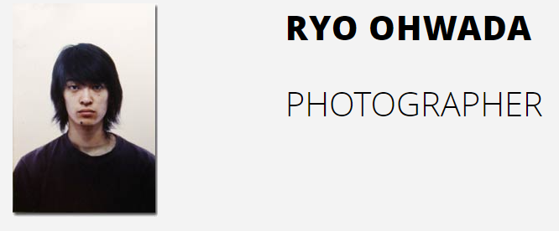
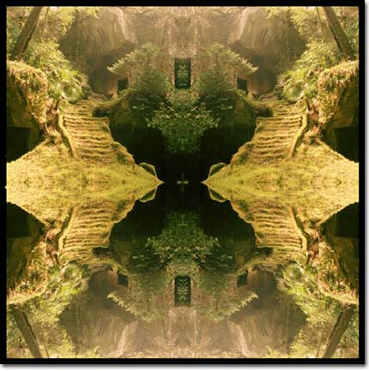

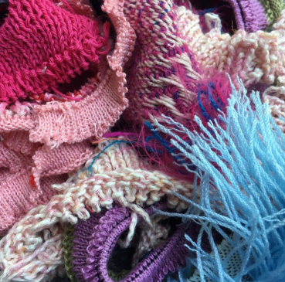
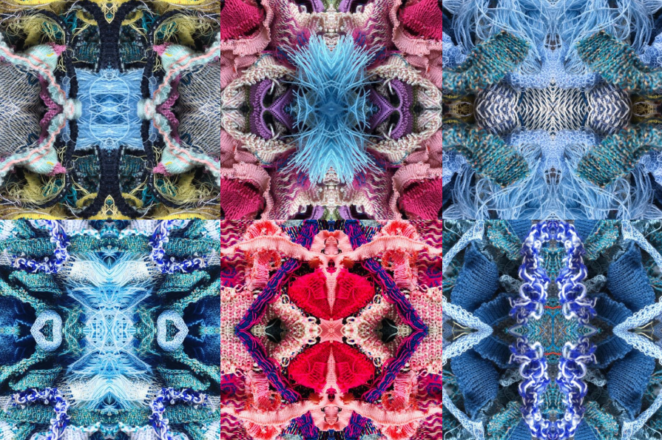
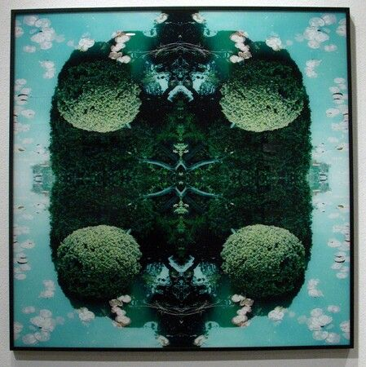
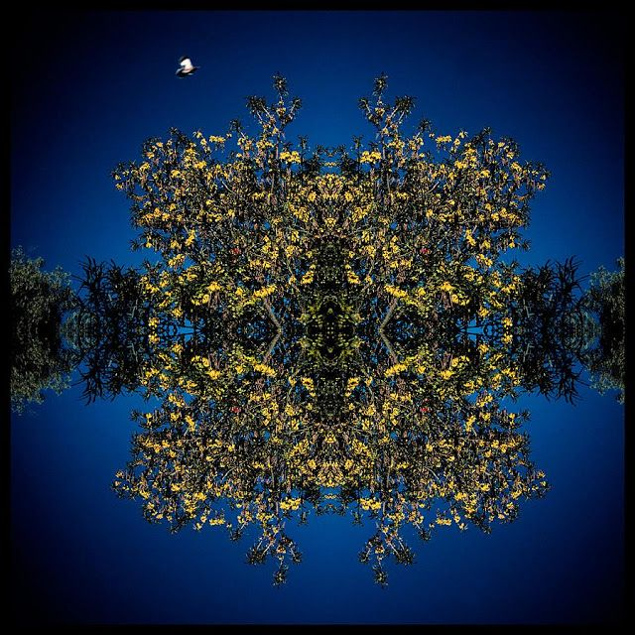
Dave – we can do this with
Flowers
Bushes outside
Fabric
Water?
Anythign really.
This idea is cool with the fabric!!! From another school.

